Slide 1
Future for Rare
Workshop
[enter your organisation name and logo here]
Notes:
Edit notes:
Please add your organisation name
Presentation notes:
You can use this slide as a holding screen before starting your workshop.

Slide 2
Welcome!
Notes:
Presentation notes:
Begin by setting a warm, inclusive tone. Welcome everyone to the space and invite participants to share their names and, if they feel comfortable, their connection to the rare conditions community If your meeting is online, you can ask attendees to introduce themselves verbally or using the chat function.
This part of the workshop should take 5-10 minutes.

Slide 3
Housekeeping
Add housekeeping notes here, for example: This workshop will be recorded for the purposes of note taking.
Notes:
Edit notes:
Please edit this slide to provide essential housekeeping details for your participants. Include whether the session is being recorded, safety and facility info for in-person meetings (such as fire exits and toilets), or specific participation guidelines. For example, you might ask virtual attendees to use the ‘raise hand’ feature or contribute via the chat function.
Presentation notes:
Spend a few minutes explaining your housekeeping guidelines.

Slide 4
Future for Rare workshop
This session aims to understand your views about the biggest challenges facing people affected by rare conditions and your suggestions for solutions to address these challenges.
The findings from this workshop will help Genetic Alliance UK to identify what specific policy changes will make a tangible difference in the lives of those affected by rare conditions.
Genetic Alliance UK will share these findings with the government teams developing proposals for a future rare conditions policy.
Notes:
Presentation notes:
Use this slide to explain why you are holding this workshop and explain the background to the Future for rare campaign.
Information to share with workshop participants:
The UK Rare Diseases Framework, the national policy for rare conditions in the UK, is due to end in January 2027. The governments of the UK are currently considering what comes next. It is very important that the views of the rare conditions community inform these decisions and help shape what the future policy looks like.
Genetic Alliance UK is an alliance of over 220 charities and support groups working together to improve the lives of people in the UK with genetic, rare and undiagnosed conditions. They are coordinating the Future for Rare campaign, in collaboration with other organisations for people with genetic, rare and undiagnosed conditions, to understand the needs of the community and gather high-quality evidence to help inform the UK government’s decisions.
This session will focus on three questions to help get your views on what a future UK policy for rare conditions needs to look like to make a difference for your rare condition, or your role in the rare condition community.
We know that you will be the absolute expert on the area of rare conditions that you live with or work with - so please focus on what you know and answer these questions based on your experiences.

Slide 5
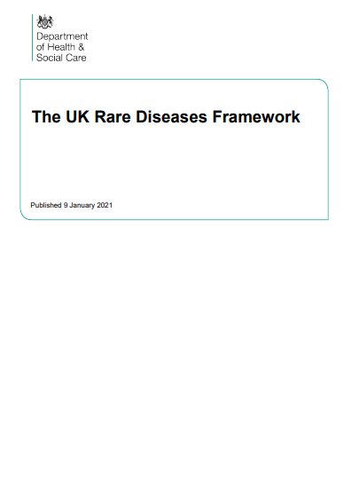
UK Rare Diseases Framework
The UK Rare Diseases Framework is a UK wide policy which aims to aims to ensure that the ‘lives of people living with rare conditions continue to improve’.
Each devolved nation is responsible for delivering their own action plans.
The Framework was published in 2021. It was due to end in January 2026 but has been extended to January 2027.
This extension allows time for discussion on what comes next.
https://www.gov.uk/government/publications/uk-rare-diseases-framework
Notes:
Presentation notes:
Use this slide to provide background to the UK Rare Diseases Framework.
Information to share with workshop participants:
The UK Rare Diseases Framework is a co-ordinated policy across all four nations. Its primary goal is to ensure the lives of people living with rare conditions continue to improve through better diagnosis and care.
Although the framework sets a UK-wide vision, delivery is decentralised. Each devolved nation is responsible for creating and implementing its own specific action plans to meet the framework's goals within its healthcare system.
The policy was first published in 2021. While it was originally intended to end in January 2026, the timeline has been extended to January 2027.
The additional year provides a window for formal consultation. This period allows stakeholders to discuss the progress made so far and determine the strategy for the next phase of rare disease policy beyond 2027.

Slide 6
UK Rare Diseases Framework
Priorities | Underpinning themes
Helping patients get a final diagnosis faster. Increasing awareness of rare diseases among healthcare professionals. Better coordination of care. Improving access to specialist care, treatments, and drugs. | Patient voice National and international collaboration Pioneering research Digital, data and technology Wider policy alignment England’s delivery of the UK Rare Diseases Framework added 'equity' as an underpinning theme
Notes:
Presentation notes:
Use this slide to outline the UK Rare Diseases Framework priorities and underpinning themes.
Information to share with workshop participants:
The UK Rare Diseases Framework currently focuses on four priorities:
Helping patients get a final diagnosis faster.
Increasing awareness of rare diseases among healthcare professionals.
Better coordination of care.
Improving access to specialist care, treatments, and drugs.
It also has five underpinning themes:
Patient Voice: Policy makers and service providers will prioritise the lived experiences of people affected by rare conditions by ensuring all commitments are developed through inclusive consultation.
National and International Collaboration: To overcome the challenges posed by small patient populations, the UK is committed to sharing knowledge and resources internationally to facilitate research and improve care.
Pioneering Research: The UK aims to maintain its status as a global leader in life sciences by increasing research funding and focusing on translating scientific breakthroughs into frontline clinical treatments.
Digital, Data and Technology: The framework seeks to utilise telemedicine to reduce travel burdens and improve data interoperability to better support healthcare delivery and research.
Wider Policy Alignment: Recognising that rare conditions impact all aspects of life, the strategy ensures that healthcare goals are integrated with wider policies regarding social care, housing, education, and specialised workforce planning.
England’s delivery of the UK Rare Diseases Framework included an additional underpinning theme from 2025: Health equity. Many people living with rare conditions and those who care for them report inequitable access to healthcare and other services.

Slide 7
Question 1
Are the current priorities and underlying themes correct?
What are the most important gaps or needs that are not covered?
Notes:
Presentation notes:
This is the first discussion point. The objective is to determine whether participants agree with the UK Rare Diseases Framework’s four priorities and underlying themes and to identify any significant gaps or needs that may have been overlooked.
Questions to ask:
Are the current priorities and underlying themes the correct ones?
What are the most important gaps or needs that are not covered?
Prompt: To help prompt discussion you could ask participants to imagine all the priorities on this list have been addressed successfully, what challenges would be left for a person living with a rare condition?

Slide 8
Question 2
What are the biggest challenges you face because of your rare condition?
What are the top five most important challenges?
Notes:
Presentation notes:
This is the second discussion point. This section focuses on the challenges your community experiences because of their rare condition.
Questions to ask:
What are the biggest challenges you face because of your rare condition?
Prompt: to help generate discussion, you could share some examples. For example, difficulty getting a diagnosis, not being able to access a specialist, not having medicines available, difficulty accessing services because of their rare condition, etc.
Facilitation note: If you are able to do so, note responses on a flipchart, whiteboard or digital whiteboard.
What are the top five most important challenges?
Facilitation note: As a group, look at the challenges discussed and try to reach an agreement on the top five most important. [If you are able to do so, note these on your flipchart, whiteboard or digital whiteboard]
NB: If you are delivering this workshop with clinicians or researchers, you could consider what barriers might exist to making progress to deliver innovation, or implement positive changes to benefit people living with rare conditions.

Slide 9
Question 3
Are there solutions that can help overcome the challenges we have identified?
Notes:
Presentation notes:
For this session, we want to move from identifying problems to proposing solutions.
Question to ask
Are there solutions that can help overcome the challenges we have identified?
Prompts:
If you were in charge of the healthcare system for a day, what one practical change would you make to solve the challenges we just listed?
What does 'good' support look like to you?
Agree your top solutions to meet the challenges you have identified.

Slide 10
Thank you!
We know that there is a tremendous amount of unmet need for people living with rare conditions in the UK. We’re convinced we need a successor to the UK Rare Diseases Framework, both to maintain our momentum, but also to make sure progress is as equitable as possible.
Everyone across the rare condition community must have a say in the future of rare condition policy, so thank you - we will make sure that the four governments of the UK get this message loud and clear.
— Nick Meade, Chief Executive, Genetic Alliance UK
Notes:
Presentation notes:
Please show the slide with a thank you from Genetic Alliance UK’s Chief Executive Nick Meade.
Close the formal discussion by thanking everyone for their contributions and time.

Slide 11
Next steps
Every insight shared helps to provide the evidence needed to shape the future of rare conditions policy in the UK.
All findings will be shared with Genetic Alliance UK for inclusion in a formal report.
The report will be presented directly to governments across the UK in Autumn 2026.
Health Ministers from across the UK will make a final decision on the future of the UK Rare Diseases Framework later in 2026.
Notes:
Presentation notes:
Explain that the contributions people have made are vital and thank participants for sharing their thoughts and experiences.
Let participants know that the findings from their workshop will be shared directly with Genetic Alliance UK (but anonymously), who will incorporate the data into a formal report. This report will be presented to governments across the UK and shared with the rare conditions community.
Remind attendees that this is a critical time, as Ministers are due to make a final decision on the future of rare conditions policy in the UK.

Slide 12
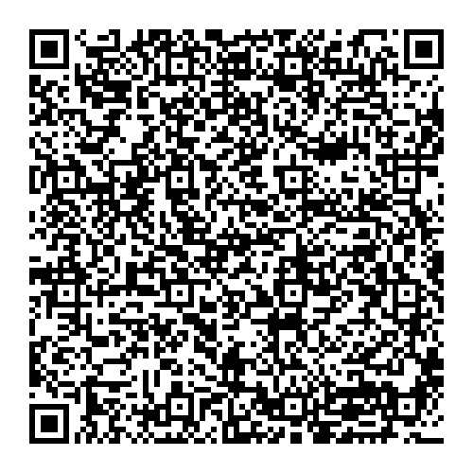
Future for Rare campaign
Would you like to hear more about Genetic Alliance UK’s Future for Rare Campaign?
Sign up for the Future for Rare email newsletter
Email futureforrare@geneticalliance.org.uk
Follow Genetic Alliance UK’s social media
Facebook @GeneticAllianceUK
Instagram @rarediseaseuk
LinkedIn linkedin.com/company/genetic-alliance-uk
YouTube @GeneticAlliance_UK
Bluesky @geneticallianceuk.bsky.social
Notes:
Presentation notes:
Please invite participants to follow the progress of the Future for Rare campaign and see how their input is being used. They can:
Follow Genetic Alliance UK on social media
Sign up for the quarterly newsletter via the website.
Any questions? Email futureforrare@geneticalliance.org.uk

